Slide 1

CS144 An Introduction to Computer Networks
Packet Switching
What is packet switching?
Nick McKeown
Professor of Electrical Engineering
and Computer Science, Stanford University
Notes:
In this video I am going to tell you about what packet switching is, and why the Internet uses packet switching.
Packet switching was first described in the early 1960s by Paul Baran. Packet switching describes the way in which individual packets of information are routed, one by one, from a source to the destination across the Internet, just like letters are delivered by the post office.
Packet switching is really important, because when we choose to use packet switching, it dictates many of the properties of the network.

Slide 2
Outline
What is Circuit Switching?
What is Packet Switching?
Why does the Internet use Packet Switching?
Notes:
Today, I’m going to explain what packet switching is, and why it was chosen for the Internet.
But first, I need to tell you about the predecessor of packet switching, called circuit switching.

Slide 3
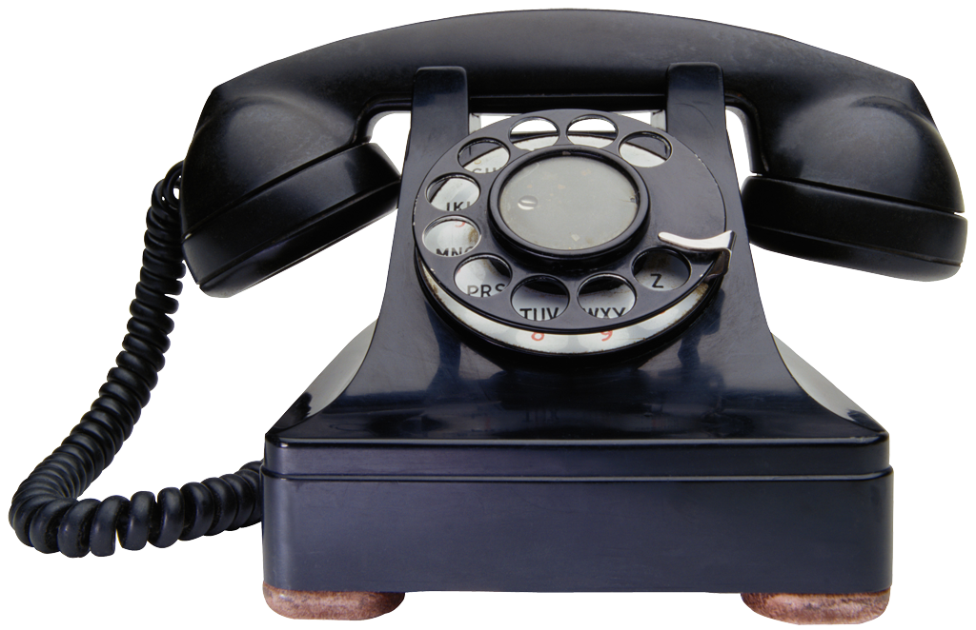
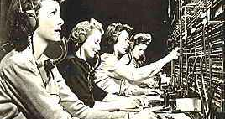
Circuit Switching
Dedicated
Wire
Dedicated
Wire
Notes:
The most common use of circuit switching is in the traditional wired telephone network. Let’s walk through what happens when we make a phone call from the phone on the left to the one on the right.
The telephones are connected by a dedicated wire to a local exchange. In the early days, a room full of switchboard operators used a big patch-panel to manually connect the dedicated wire from one phone, to the dedicated wire of the other phone. The main point is that the wire is dedicated to the phone conversation from the start to the end of the phone call.

Slide 4
Circuit Switching
Dedicated
Wire
Dedicated
Wire
Circuit Switch
Notes:
Nowadays of course we don’t have rooms full of switchboard operators. Instead, these automatic circuit switches set up the circuit for us from our phone to our friend’s phone at the other end. It helps to think of a phone call having three phases. First, we pick up the handset and dial a number, which creates a dedicated circuit between the two phones. Each switch maintains state to map the incoming circuit to the correct outgoing circuit. In the second phase, we talk. In a digital phone system, our voice is sampled and digitized, and sent over the dedicated circuit, which is typically 64kb/s for voice. Our phone conversation has a dedicated circuit, or channel, all the way along the path, and the circuit is not shared with anyone else. Finally, when we hang up, the circuit is removed, and any state is removed at the switches along the path.

Slide 5
Circuit Switching
Each phone call allocated 64kb/s.
A 10Gb/s trunk line can carry over 150,000 calls.
Source
“Caller”
Destination
“Callee”
Central
Office
(C.O.)
Central
Office
(C.O.)
Trunk
Exchange
Notes:
In practice, the trunk lines between switching centers are really fast – in other words they have a very high data rate. Even the slow ones run at 2.4Gb/s, and the fastest ones today run at 40 or even 100Gb/s. Sometimes you’ll hear people call these trunk lines “big fat pipes” because of the volume of data they can send. But these big fat pipes are really tiny skinny little optical fibers thinner than one of your hairs. Many thousands of phone calls share the same trunk line between cities, each in its own circuit. The key thing to remember is that every phone call has its own dedicated 64kb/s circuit that it doesn’t have to share with anyone else.

Slide 6
Circuit Switching
Each call has its own private, guaranteed, isolated data rate from end-to-end.
A call has three phases:
Establish circuit from end-to-end (“dialing”)
Communicate
Close circuit (“tear down”)
Originally, a circuit was an end-to-end physical wire.
Nowadays, a circuit is like a virtual private wire.
Notes:
So in summary…..

Slide 7
Problems
Inefficient. Computer communication tends to be very bursty. e.g. typing over an ssh connection, or viewing a sequence of web pages. If each communication has a dedicated circuit, it will be used very inefficiently.
Diverse Rates. Computers communicate at many different rates. e.g. a web server streaming video at 6Mb/s, or me typing at 1 character per second. A fixed rate circuit will not be much use.
State Management. Circuit switches maintain per-communication state, which must be managed.

Slide 8
Outline
What is Circuit Switching?
What is Packet Switching?
Why does the Internet use Packet Switching?

Slide 9
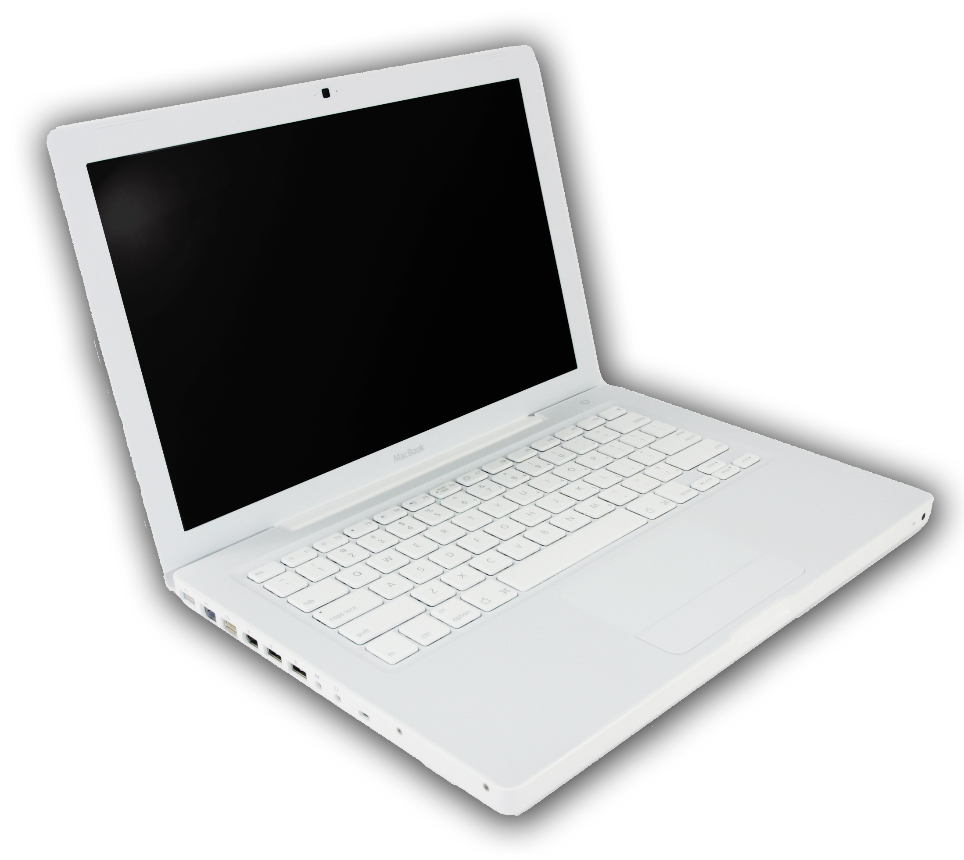

Packet Switching
Data
Header
Data
B
A
B
Packet Switch
Address | Next-hop
B | S₂
C | S₃
D | S₃
S₂
S₁
S₄
S₃
C
D
Notes:
In packet switching, there is no dedicated circuit to carry our data. Instead, we send a block of data by adding a header to it, and call it a packet. The header contains the address of where the packet is going, just like an envelope tells the post office where to send a letter.
_{<click to send packet on link>} A packet switched network consists of end-hosts, links, and packet switches. When we send a packet, it is routed hop-by-hop to its destination. Each packet switch lookups the address in the packet header in its local forwarding table.
For example, this packet is addressed to B. When we transmit it, the first router looks up address B in its local table, and sees that switch S2 is the next hop. S2 and S4 do the same thing, and the packet is eventually delivered to B.In the Internet there are several different types of packet switches. Some of them are called routers or gateways, while others are called Ethernet switches. We’ll learn more about each of them later. At this stage you just need to know that they are both types of packet switch, and they forward packets based on the destination address in the header.

Slide 10
Packet Switching
Packet Switch
Notes:
Of course, at any instant there are many packets flowing across the Internet, all being individually routed hop-by-hop. They all share all the links along the path with other packets going to different destinations.

Slide 11
Packet switches have buffers
Data
H
Data
H
Buffers hold packets:
When two or more packets arrive at the same time
During periods of congestion

Slide 12
Packet Switching
A
H
B
R2
Source
R1
R3
Destination
R4
Packets are routed individually, by looking up address in router’s local table.
All packets share the full capacity of a link.
The routers maintain no per-communication state.

Slide 13
Outline
What is Circuit Switching?
What is Packet Switching?
Why does the Internet use Packet Switching?

Slide 14
Efficient use of expensive links
Links were assumed to be expensive and scarce.
Packet switching allows many, bursty flows to share the same link efficiently.
“Circuit switching is rarely used for data networks, ... because of very inefficient use of the links” – Bertsekas/Gallager
Resilience to failure of links & routers
“For high reliability, ... [the Internet] was to be a datagram subnet, so if some lines and [routers] were destroyed, messages could be ... rerouted” - Tanenbaum
Notes:
Breaking message into packets allows parallel transmission across all links, reducing network latency.
In summary the benefits that of packet switched networks can be summarized as follows:
They use the bandwidth efficiently, meaning that a trunk link uses less resources than the sum of its tributaries, as they multiplex and conserve bandwidth
They have little state in the intermediate nodes
They are robust, some claim that they were designed to withstand a nuclear attack
They do not have a central authority from whom we need permission to run experiments

Slide 15
Summary
What is Circuit Switching?
What is Packet Switching?
Why does the Internet use Packet Switching?
Notes:
By now you should be able to answer these three quesitons.

Slide 16
<End>

